Slide 1
Hadoop and Kerberos: The madness beyond the gate
Steve Loughran
stevel@hortonworks.com
@steveloughran
2016

Slide 2

Me: Before Kerberos

Slide 3

After Kerberos

Slide 4
Leave now if you want to retain your life of naïve innocence

Slide 5
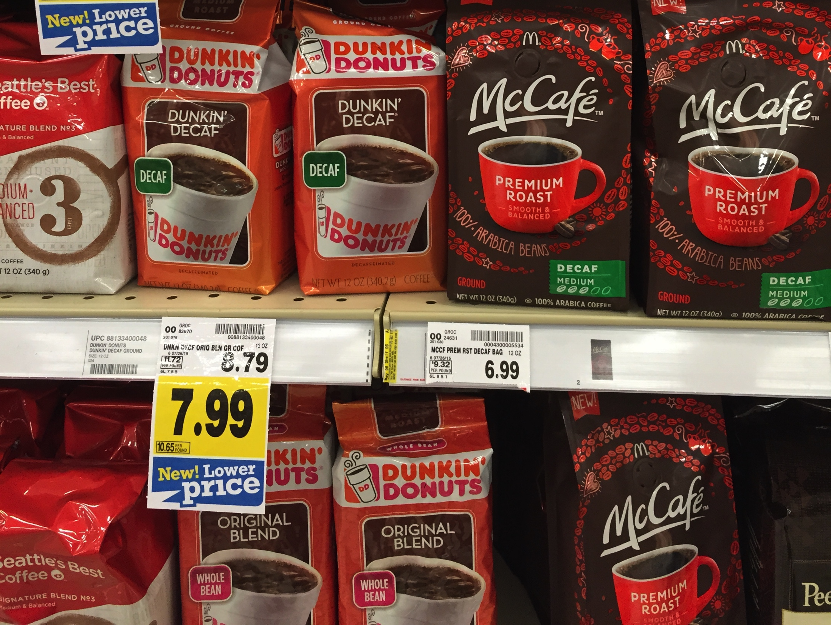
Notes:
Enough people like Dunkin Donut's decaf coffee that you can buy it for home use —and supermarkets will stock it next to the MacDonalds coffee.

Slide 6
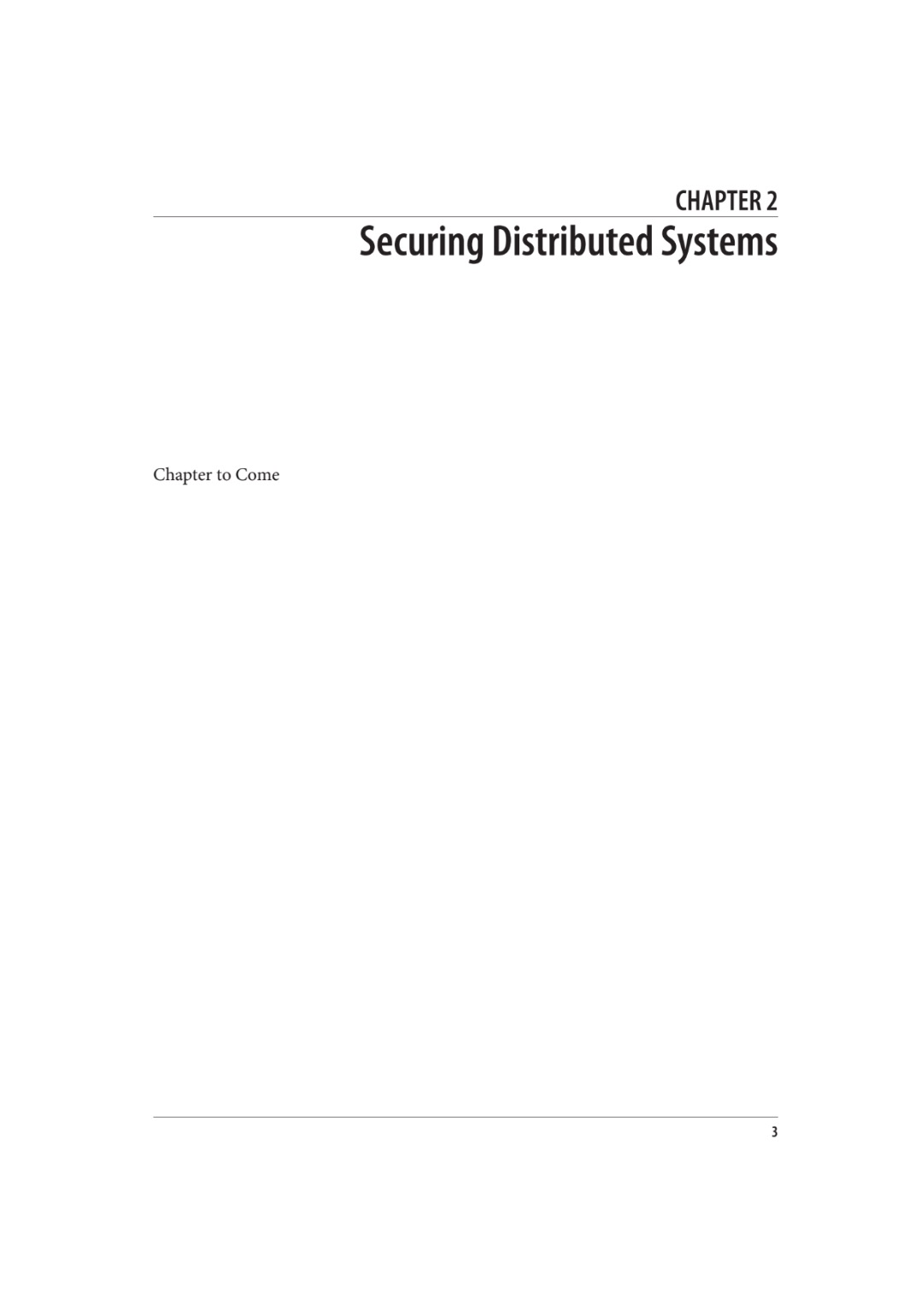

Slide 7
export HADOOP_USER="root"
Notes:
This is your get out clause. Turn off encryption. Users are who they claim to be; the environment variable HADOOP_USER can change it on a whim.

Slide 8
Modern Hadoop clusters are locked down through Kerberos
Notes:
..which is why production clusters are all locked down with kerberos.
Callout: this doesn't cover authorization/access control (exception: Hadoop IPC acls), wire encryption, HTTPS or data encryption.

Slide 9
You cannot hide from Kerberos You may choose when Kerberos finds you
Notes:
So you can't ignore Kerberos. You only get a choice about when to encounter it
-early on in your coding and testing
-during final integration tests
-in late night support calls.

Slide 10
Kerberos: the dog at the gate to hell

Slide 11

This is not a metaphor
Art: Andrés Álvarez Iglesias
Notes:
Photo: https://www.flickr.com/photos/doctorserone/4635167170/
Andrés Álvarez Iglesias

Slide 12
HP Lovecraft | Kerberos
Evil lurking in New England | MIT Project Athena
Ancient, inhuman deities | Kerberos Domain Controller
Manuscripts to drive the reader insane | IETF RFC 4120
Entities never spoken of aloud | UserGroupInformation
Doomed explorers of darkness | You

Slide 13





Kerberos is the gateway
Client
Kerberos Domain Controller
Principal
(P, TGS, n₁)
Authentication Service
{K_{P.TGS}, n₁}_{KP}, {ticket(P,TGS)} _{KTGS}
K_{P}
Ticket(P, TGS) = (TGS, P, t_{start}, t_{end}, K_{PT)}
{auth(P)}_{KP.TGS},{ticket(P,TGS)}_{KTGS,}S,n₂
K_{P}
Ticket Granting Service
user@REALM
user/hostname@REALM
{K_{P.S}, n₂}_{KP}, {ticket(P,S)} _{KS}
K_{TGS}
auth(P)_{KP.TGS} = {P, time)}_{KP.TGS}
Notes:
The KDC is managed by the enterprise security team. They are either paranoid about security, or your organisation is 0wned by everyone from Anonymous to North Korea. They don't trust you, they don't trust Hadoop, and make the rest of the network ops people seem welcoming.
You will need to work with these people.

Slide 14
Every service is a principal
alice@REALM
bob@REALM
oozie/ooziehost@REALM
namenode/nn1@REALM
hdfs/_HOST@REALM hdfs/r04s12@REALM hdfs/r04s13@REALM
yarn/_HOST@REALM yarn/r04s12@REALM
HTTP/_HOST@REALM
short names: alice bob oozie namenode hdfs yarn HTTP

Slide 15
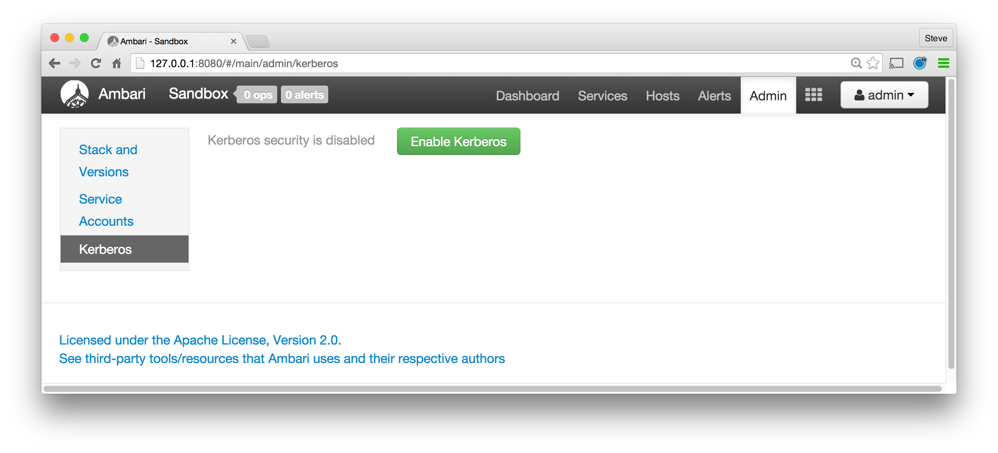
Entering the darkness

Slide 16



HDFS Bootstrap: Kerberos Login
namenode/nn@REALM
log in to kerberos
tickets for TGS
datanode/_HOST@REALM
shared keytab in /etc/hadoop

Slide 17
HDFS Bootstrap: DNs register with NN
namenode/nn@REALM
DN registration
Request ticket for namenode/nn@REALM
ExportedBlockKeys
Ticket for namenode/nn@REALM
datanode/_HOST@REALM
shared keytab in /etc/hadoop

Slide 18
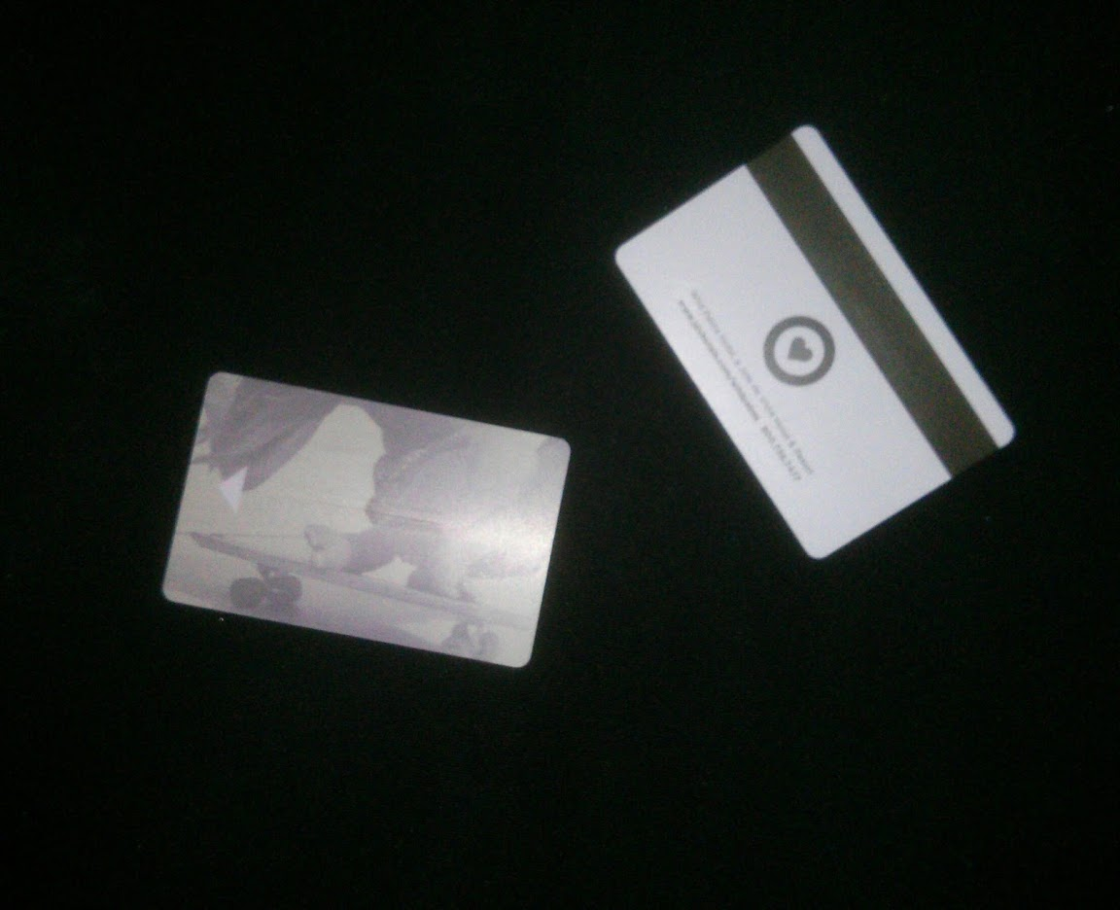
Hadoop Tokens
Notes:
Photo: https://www.flickr.com/photos/doctorserone/4635167170/
Andrés Álvarez Iglesias

Slide 19
Hadoop Tokens
Issued and tracked by individual services (HDFS, WebHDFS, Timeline Server, YARN RM, …)
Grant some form of access: Block tokens, Delegation Tokens
Can be forwarded
Renewable via service APIs (RPC, HTTP)
Revocable in server via service APIs
read: O'Malley 2009, Hadoop Security Architecture

Slide 20
HDFS IO: Block Tokens
namenode/nn@REALM
open("file")
BlockToken
Obtain ticket for namenode/nn@REALM
alice@REALM
BlockToken
BlockToken: userId, (BlockPoolId, BlockId), keyId, expiryDate, access-modes

Slide 21

Delegation Tokens delegate access
namenode/nn@REALM
Token
Request delegation token
HDFS Delegation Token
service/host@REALM
HDFS Delegation Token
BlockToken
HDFS Delegation Token
Obtain ticket for namenode/nn@REALM
alice@REALM
BlockToken

Slide 22

YARN Applications
namenode/nn@REALM
Token
Request delegation token
resourcemanager/rm@REALM
HDFS Delegation Token
Launch Context
HDFS
Obtain ticket for resourcemanager/rm@REALM
Obtain ticket for namenode/nn@REALM
AM/RM'
alice@REALM
AM/RM
HDFS
Launch Context
Refresh AM/RM
HDFS
HDFS
AM/RM
AM/RM'
AM/RM
HDFS
AM/RM'
AM/RM
alice
nodemanager/_HOST@REALM

Slide 23
That which must not be named: UGI
if(!UserGroupInformation.isSecurityEnabled()) {
stayInALifeOfNaiveInnocence();
} else {
sufferTheEternalPainOfKerberos();
}
UserGroupInformation.checkTGTAndReloginFromKeytab();
UserGroupInformation.getLoginUser() // principal logged in as
UserGroupInformation.getCurrentUser() // principal acting as

Slide 24
UGI.doAs()
UserGroupInformation bob =
UserGroupInformation.createProxyUser("bob",
UserGroupInformation.getLoginUser());
FileSystem userFS = bob.doAs(
new PrivilegedExceptionAction<FileSystem>() {
public FileSystem run() throws Exception {
return FileSystem.get(FileSystem.getDefaultUri(), conf);
}
});

Slide 25
Services
RPC authentication via annotations & metadata in JAR
YARN Web UIs: rely on RM proxy for authentication
Authentication != Authorization
Add audit logs on service endpoints
YARN services: come up with a token refresh strategy: keytab everywhere; keytab in AM; update from client

Slide 26
Hadoop RPC
@KerberosInfo(serverPrincipal = "my.kerberos.principal")
public interface MyRpc extends VersionedProtocol { … }
public class MyRpcPolicyProvider extends PolicyProvider {
public Service[] getServices() {
return new Service[] {
new Service("my.protocol.acl", MyRpc.class)
};
}
}
public class MyRpcSecurityInfo extends SecurityInfo { … }
META-INF/services/org.apache.hadoop.security.SecurityInfo org.example.rpc.MyRpcSecurityInfo

Slide 27
IPC Server: get the current user identity
Messages.KillResponse killContainer(Messages.KillRequest request) {
UserGroupInformation callerUGI;
try {
callerUGI = UserGroupInformation.getCurrentUser();
} catch (IOException ie) {
LOG.info("Error getting UGI ", ie);
AuditLogger.authFail("E_UNKNOWN", "killContainer",
"Error getting UGI", ie);
throw RPCUtil.getRemoteException(ie);
}
…

Slide 28
IPC Server: Authorize
String user = callerUGI.getShortUserName();
if (!checkAccess(callerUGI, MODIFY)) {
AuditLog.unauth(user,
KILL_CONTAINER_REQUEST, callerUGI,
"User doesn't have permissions to " + MODIFY);
throw RPCUtil.getRemoteException(
new AccessControlException(
+ user + " lacks access "
+ MODIFY_APP.name()));
}
AuditLog.authorized(user, KILL_CONTAINER_REQUEST)

Slide 29
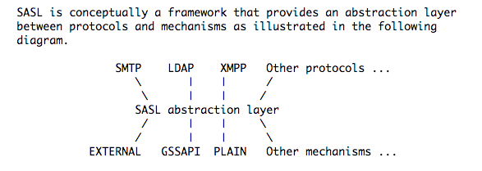
SASL: RFC4422

Slide 30
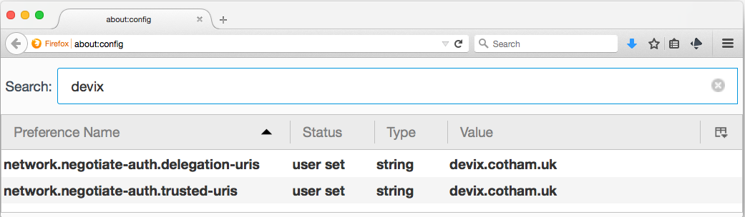
REST: SPNEGO (+ Delegation tokens)
Jersey + java.net
httpclient? “if lucky it'll work”
HADOOP-11825: Move timeline client Jersey+Kerberos+UGI support into a public implementation
Notes:
AuthenticatedURL
DelegationTokenAuthenticatedURL
org.apache.hadoop.hdfs.web.URLConnectionFactory
org/apache/spark/deploy/history/yarn/rest in SPARK-1537

Slide 31
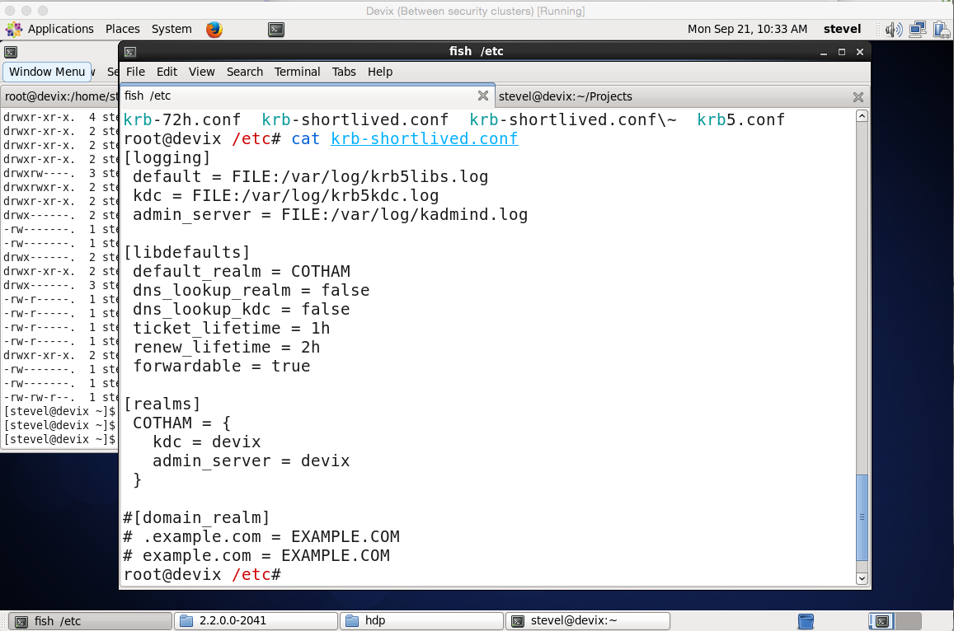
Testing
Notes:
There is a mini KDC, "MiniKDC" in the Hadoop codebase. I've used this in the YARN-913 registry work; its good for verifying that you got through the permissions logic, and for learning various acronyms. And at the end of the run you get tests that Jenkins can run every build.
But I've embraced testing against kerberized VMs, where you do the work of creating keytabs, filling in the configuration files, requiring SPENGO authed web browsers, having your command line account kinit in regularly, services having tokens expire, etc. etc. Why? Because its what the real world is like. L

Slide 32
Error messages to fear
Failure unspecified at GSS-API level (Checksum failed)
No valid credentials provided (Failed to find any Kerberos tgt)
Server not found in Kerberos database
Clock skew too great
Principal not found
No valid credentials provided (Illegal key size)
Art: Andrés Álvarez Iglesias
Notes:
Error messages with UGI are usually a sign of trouble
Photo: https://www.flickr.com/photos/doctorserone/4635167170/
Andrés Álvarez Iglesias

Slide 33
System Properties for debugging
-Dsun.security.krb5.debug=true
-Dsun.security.spnego.debug=true
export HADOOP_JAAS_DEBUG=true

Slide 34

HADOOP-12649
Fix Kerberos

Slide 35
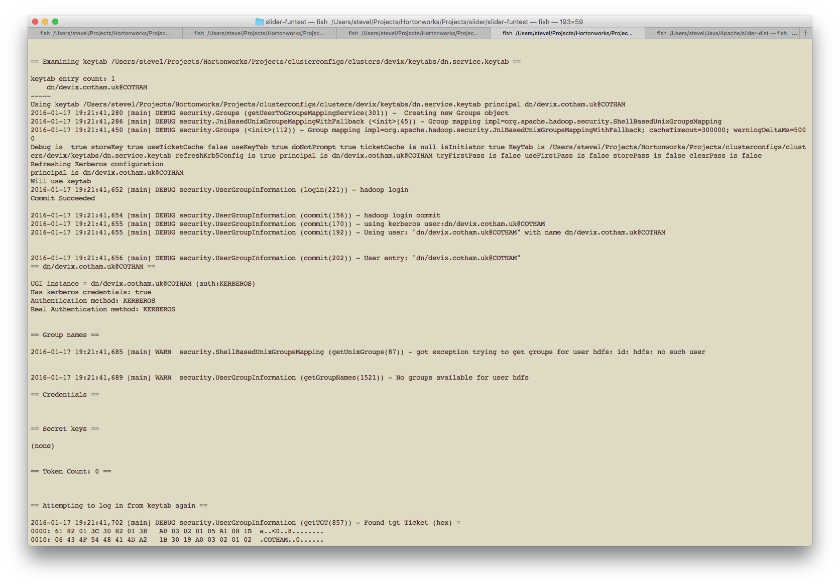
KDiag

Slide 36

gitbook.com/@steveloughran
HADOOP-12649

Slide 37
Topics Avoided Not Covered
Trying to use HTTPS in a YARN application
Trying to use Full REST in a YARN application
Group management
HADOOP_PROXY_USER
Oozie

Slide 38
Questions?
gitbook.com/@steveloughran
Art: Andrés Álvarez Iglesias
Notes:
Photo: https://www.flickr.com/photos/doctorserone/4635167170/
Andrés Álvarez Iglesias

Slide 39
Zookeeper
SASL to negotiate security:
System.setProperty("zookeeper.sasl.client", "true");
Zookeeper needs JAAS
Default permissions: wide open
Permissions are not transitive down the tree
List<ACL> perms = new ArrayList<>();
if (UserGroupInformation.isSecurityEnabled()) {
perms(new ACL(ZooDefs.Perms.ALL, ZooDefs.Ids.AUTH_IDS));
perms.add(new ACL(ZooDefs.Perms.READ,ZooDefs.Ids.ANYONE_ID_UNSAFE));
} else {
perms.add(new ACL(ZooDefs.Perms.ALL, ZooDefs.Ids.ANYONE_ID_UNSAFE));
}
zk.createPath(path, null, perms, CreateMode.PERSISTENT);

Slide 40
JAAS
Java Authentication and Authorization Service
Core Kerberos classes and types (Principal)
Text files to configure
Different for different JVMs
Need to double escape \ for windows paths
UGI handles setting up a JAAS context & logging in
Zookeeper needs JAAS

Slide 41
Glossary
KDC: Kerberos Domain Controller
TGT/"krbtgt" Ticket Granting Ticket
Simple Authentication and Security Layer (SASL)
GSSAPI Generic Security Service Application Program Interface (RFC-2743+ others)
JAAS: Java Authentication and Authorization Service
SPNEGO: Simple and Protected GSSAPI Negotiation Mechanism

